Slide 1
Web Server Deployment
using CI/CD pipeline

Slide 2
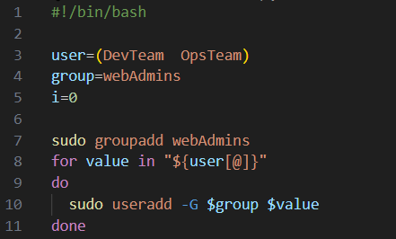
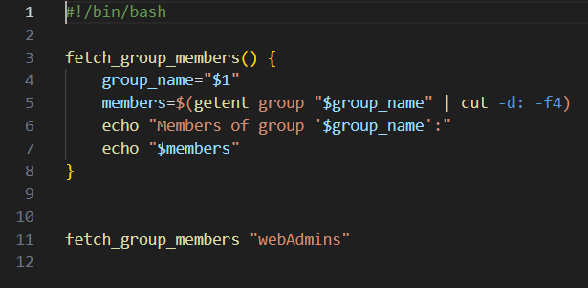
Bash script
Add users script
Fetch group members script

Slide 3
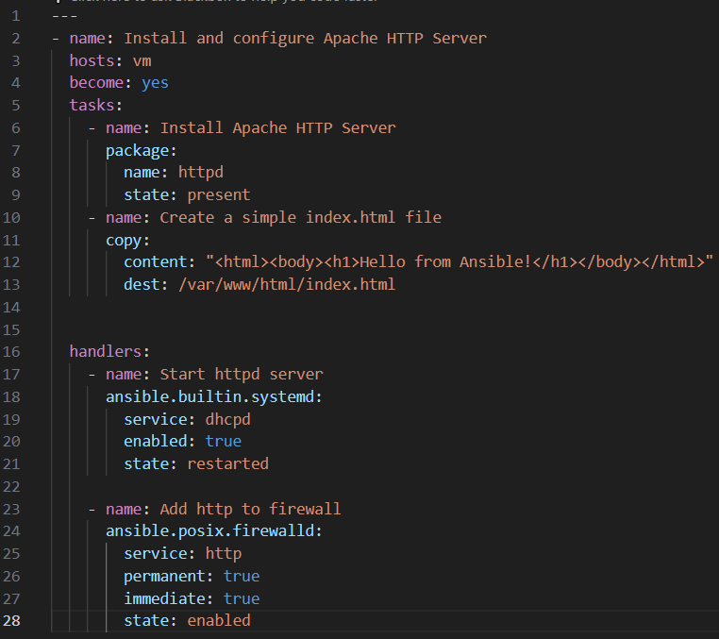
Ansible playbook
The playbook consists of several tasks, each performing a specific action, starting with the installation and configuration then creating a simple html page shows “hello from ansible!”.

Slide 4
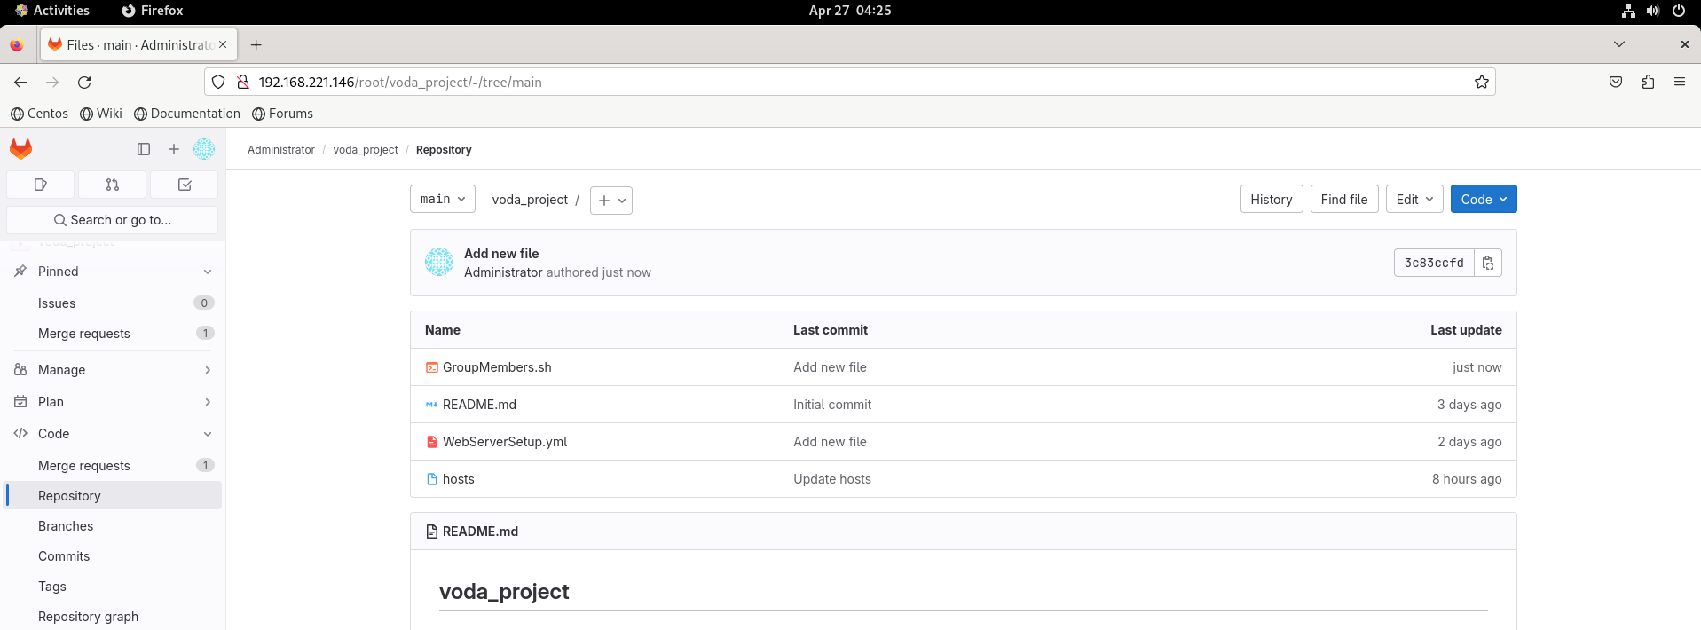
Gitlab server
After installing the GitLab and configure it , I made the repo where the project will be .
Then configured the integration of Jenkins with GitLab.

Slide 5
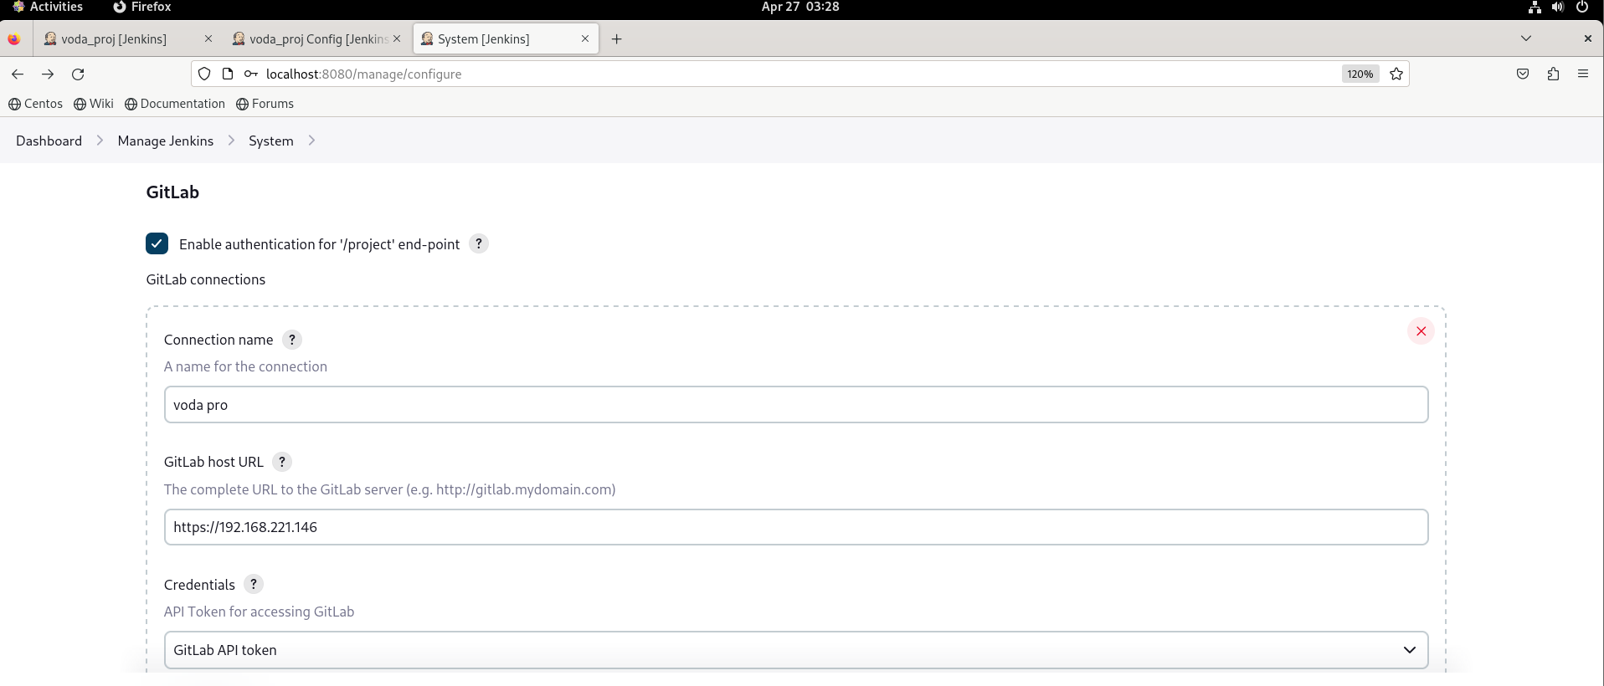
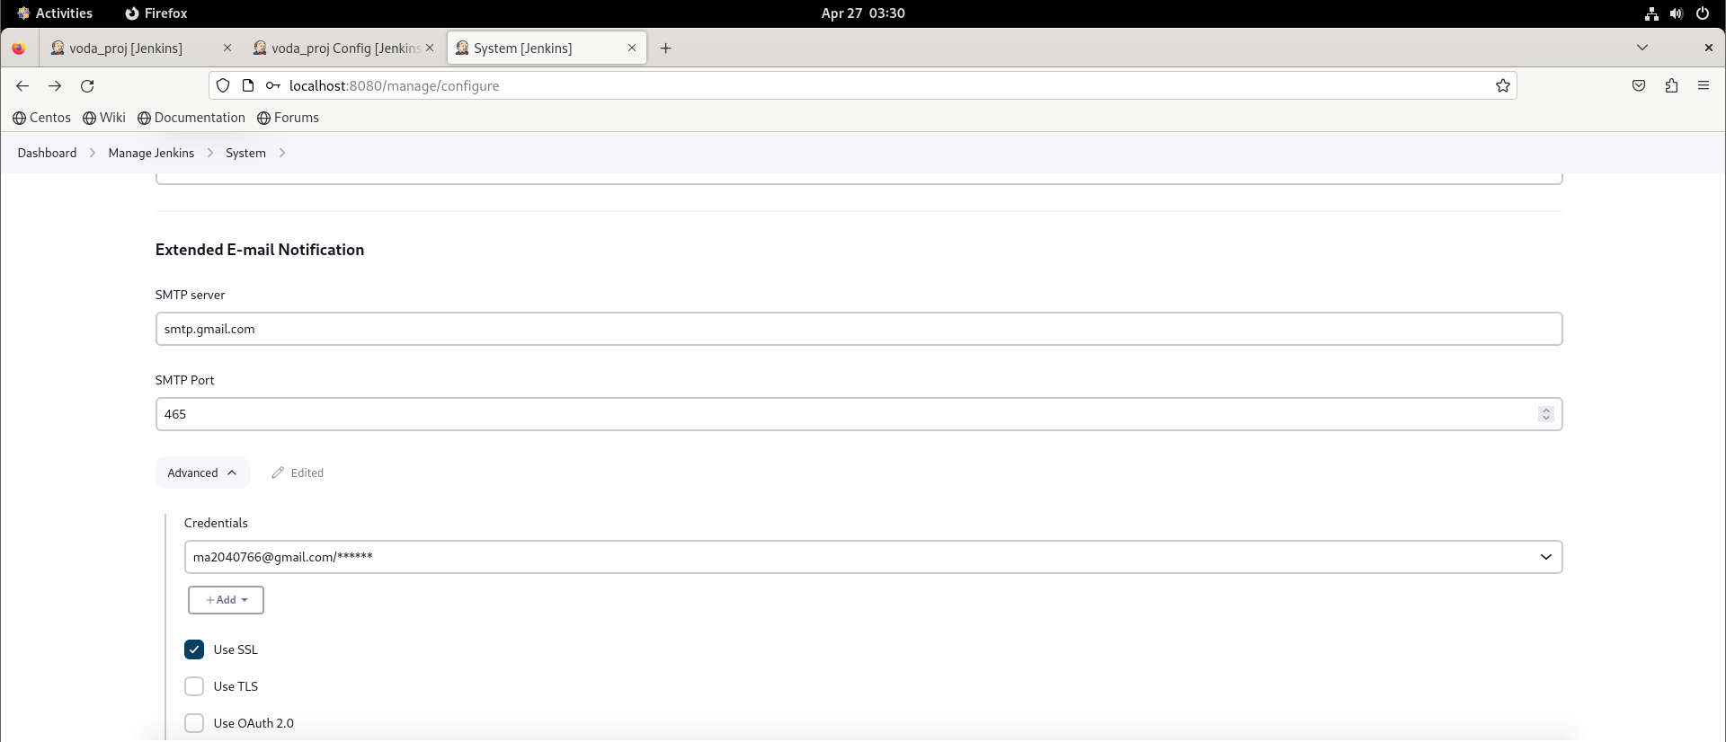
Jenkins server
Gitlab connection
Email notification configuration

Slide 6
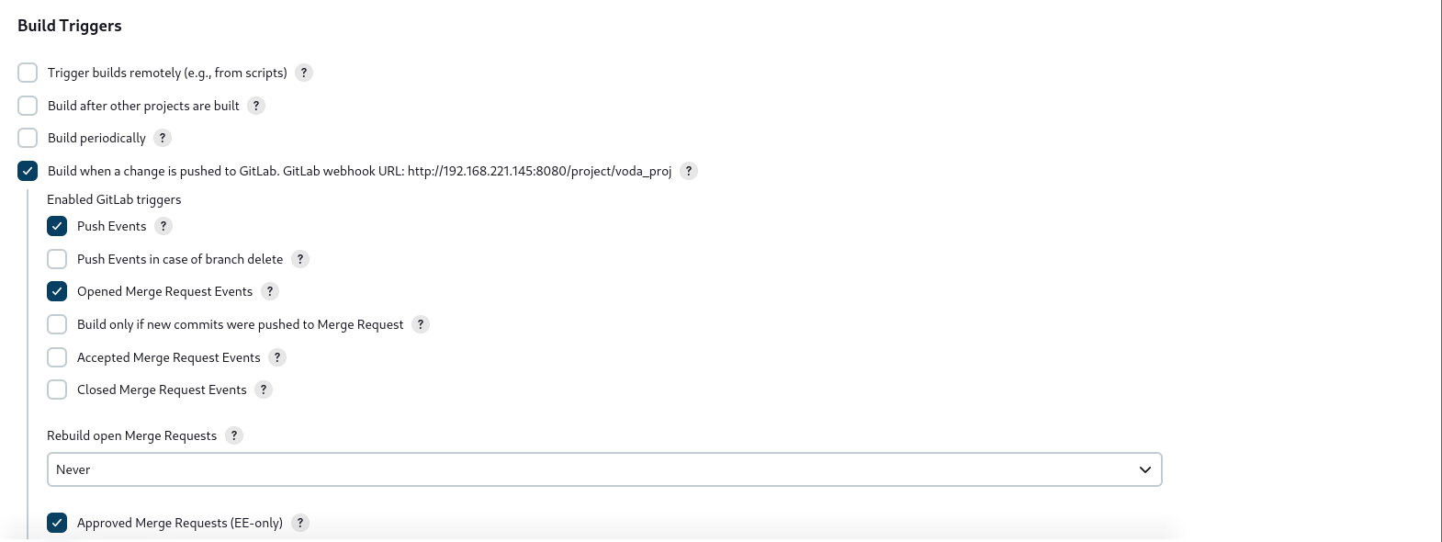
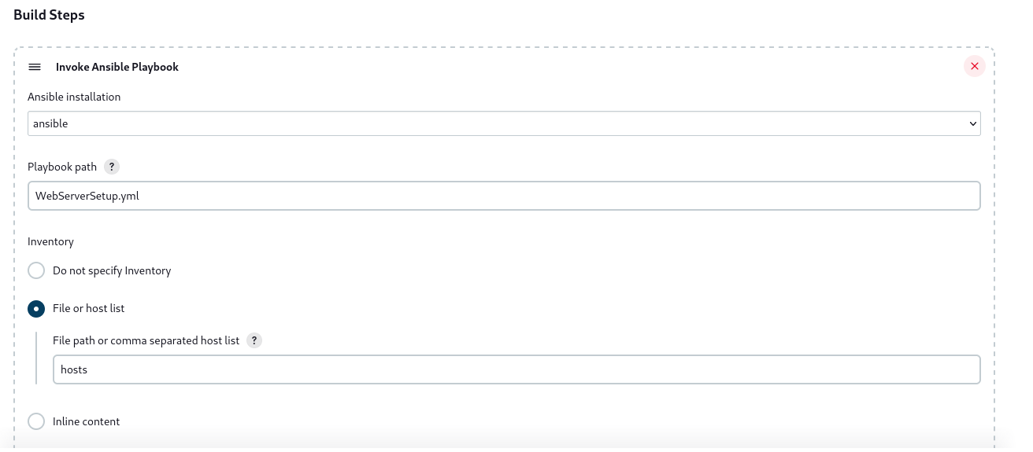
Freestyle job

Slide 7
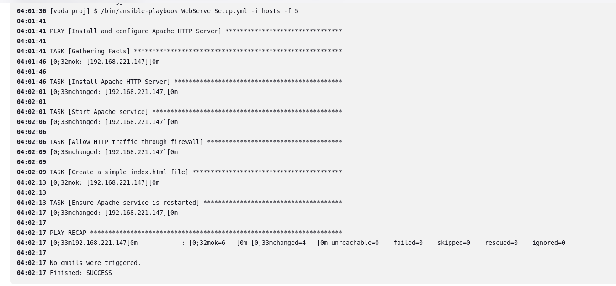
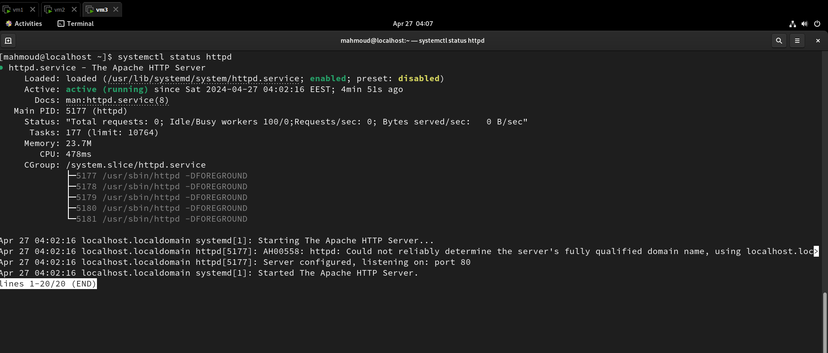
In case of success :

Slide 8
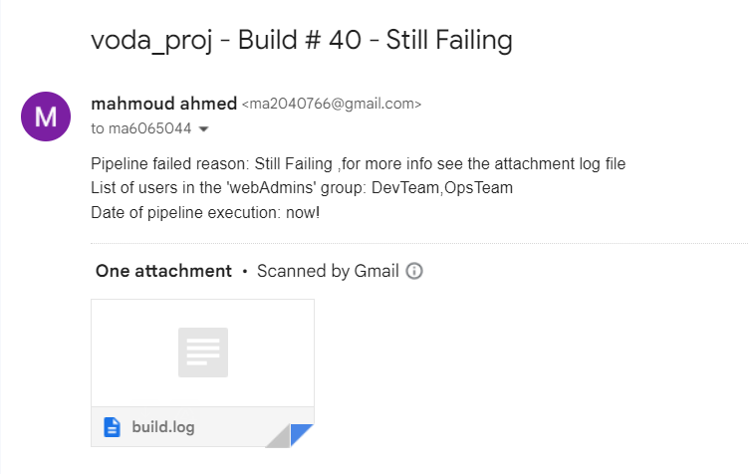
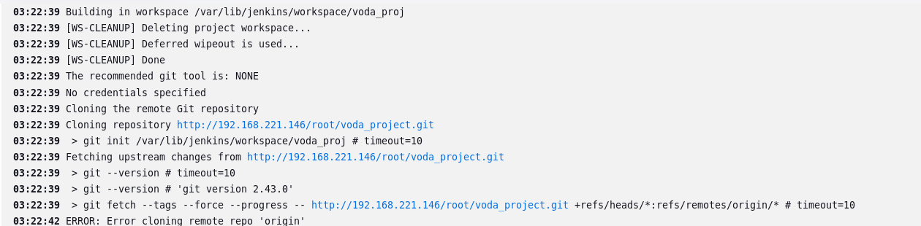

In case of failure :

